Slide 1
Chapter 10. Applying Responsibility Assignment Patterns (Part 2)
GRASP
Singleton

Slide 2
Commonly Used Design Patterns
The General Responsibility Assignment Software Patterns (GRASP)
The Gang of Four Patterns is from the four authors of the book.
10-<number>

Slide 3
GRASP Patterns
Expert
Creator
Controller
Low coupling
High cohesion
Polymorphism
Pure fabrication
Indirection
Do not talk to strangers
10-<number>

Slide 4
Applying GRASP through a Case Study
Examine a commonly seen design.
Discuss its pros and cons.
Apply a GRASP pattern to improve.
Discuss how the pattern improves the design.
During this process, software design principles are explained.
10-<number>

Slide 5
A Checkout Sequence Diagram
presentation
: CheckoutGui
: DBMgr
l: Loan
d:Document
msg := checkOut
(callNo:String): String
<<call number >>
Patron
business objects
d := getDocument (callNo: String):
Document
alt
[d!=null]
a:=isAvailable():boolean
alt
GUI is assigned too many responsibilities.
create(p:Patron, d:Document)
[a]
save(l:Loan)
setAvailable(false:boolean)
save(d:Document)
msg := “Checkout successful.”
[else] msg := “Document not available.”
[else]
Tight coupling between presentation and business objects
msg := “Document not found.”
<<msg>>
10-<number>

Slide 6
Problems with This Design
Tight coupling between the presentation and the business objects.
The presentation has been assigned too many responsibilities.
The presentation has to handle actor requests (also called system events).
Implications
  Not designing “stupid objects.”
  Changes to one may require changes to the other.
  Supporting multiple presentations is difficult and costly.
10-<number>

Slide 7
A Better Solution
Reduce or eliminate the coupling between presentation and business objects.
  the Low Coupling design principle
Remove irrelevant responsibilities from the presentation.
  the separation of concerns principle
  it achieves high cohesion and
  designing “stupid objects”
Have another object (class) to handle actor requests (system events).
10-<number>

Slide 8
Who Should Handle an Actor Request?
:CheckoutGUI
?
<<uid, cnList>>
msg:=checkout(uid, cnList):
String
<<msg>>
Assign the responsibility for handling an actor request to a controller.
:CheckoutGUI
:CheckoutController
<<uid, cnList>>
msg:=checkout(uid, cnList):
String
<<msg>>
10-<number>

Slide 9
The Controller Pattern
Actor requests should be handled in the business object layer.
Assign the responsibility for handling an actor request to a controller.
The controller may delegate the request to business objects.
The controller may collaborate with business objects to jointly handle the actor request.
10-<number>

Slide 10
Types of Controller
Use case controller
  It handles all actor requests relating to a use case.
    A checkout controller handles all actor requests to check out a document.
Role controller
  It represents a role played by an actor (Librarian, Bank Teller).
Facade controller
  It represents the overall system (Library System, Banking System).
  It represents the organization (Library, Bank).
10-<number>

Slide 11
Applying the Controller Pattern
Descending Preference:
  Use case controller
  Role controller
  Façade (System) controller
  Organization controller
Applying role controller or facade controller
  When there are only a few system events and system will not expand in the future.
  When it is not possible to handle the actor request by using a use case controller.
    example: interlibrary loan
10-<number>

Slide 12
Applying Use Case Controller
Each use case has its own use case controller:
  Checkout Controller for Checkout Use Case
  Return Controller for Return Use Case
There is only one controller for each use case.
There is a one-to-one correspondence:
  Checkout Use Case, Checkout GUI, Checkout Controller
  Login Use Case, Login GUI, Login Controller
The use case controller maintains the state of the use case, and identifies out-of-sequence system events.
10-<number>

Slide 13
Benefits of The Controller Pattern
Separation of concerns
High cohesion
Low coupling
Supporting multiple interfaces
Easy to change and enhance
Improving software reusability
It can keep track of use case state, and ensure that the correct sequence of events is being handled.
10-<number>

Slide 14
Liabilities of The Controller Pattern
More classes to design, implement, test and integrate.
Need to coordinate the developers who design and implement the UI, controllers and business objects.
  This is not a problem when the methodology is followed.
If not designed properly, it may result in bloated controllers.
10-<number>

Slide 15
Bloated Controller
A bloated controller is one that is assigned too many unrelated responsibilities.
Symptoms
  There is only one controller to handle many actor requests.
    This is often seen with a role controller or a facade controller.
  The controller does everything to handle the actor requests rather than delegating the responsibilities to other business objects.
  The controller has many attributes to store system or domain information.
10-<number>

Slide 16
Cures to Bloated Controllers
Symptoms
  only one controller to process many system events
  the controller does all things rather than delegating them to business objects
  the controller has many attributes to maintain system or domain information
Cures
  replace the controller with use case controllers to handle use case related events
  change the controller to delegate responsibilities to appropriate business objects
  apply separation of concerns: move the attributes to business objects or other objects
10-<number>

Slide 17
What Should the Checkout Controller Do?
:Checkout
GUI
:Checkout
Controller
:DBMgr
<<uid,
cnList>>
<<access db>>
msg:=checkout
(uid, cnList): String
<<get ?>>
<<process info>>
<<update>>
<<update db>>
<<msg>>
What should the controller get from the DBMgr?
How should the controller process the result?
How should the controller update the database?
10-<number>

Slide 18
Conventional Design
:Checkout
GUI
:Checkout
Controller
:DBMgr
<<uid,
callNo>>
msg:=checkout (uid,
callNo): String
b1:=hasPatron (uid): boolean
[b1]: msg:=process
(callNo): String
UML 1.0 conditional check
b2:=isAvailable (callNo):
boolean
[b2] setAvailable (callNo,false)
[b2] setCheckout(uid, callNo)
<<msg>>
10-<number>

Slide 19
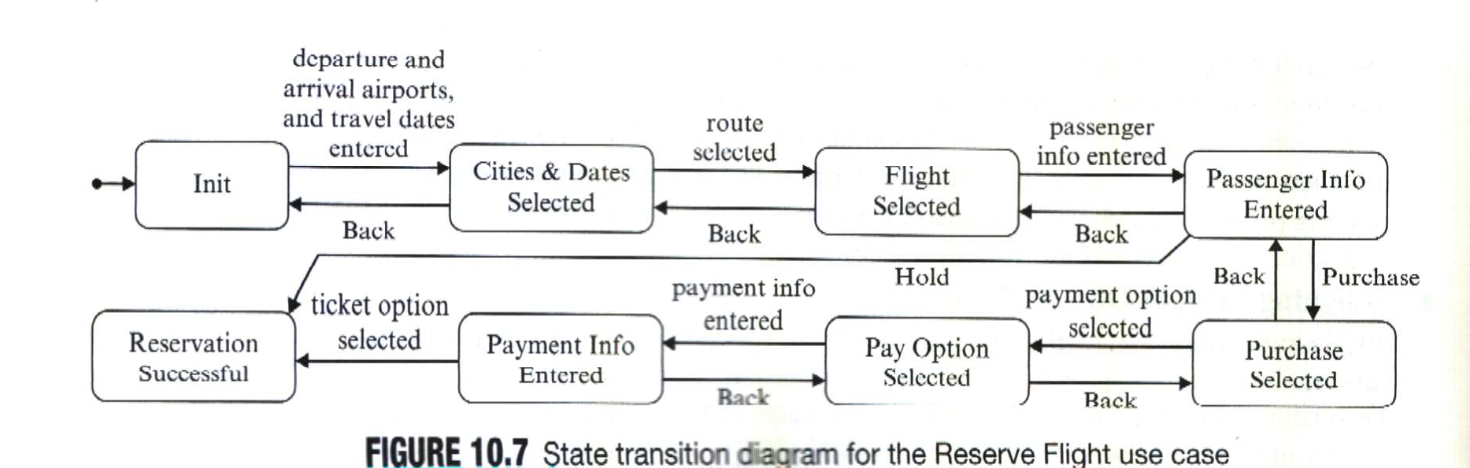
10-<number>

Slide 20
Problems with the Conventional Design
The database manager has to know a lot of database detail.
The database manager is not “stupid.”
Responsibilities are not correctly assigned.
It is designed with a procedural programming mindset!
It is not an object-oriented design!
10-<number>

Slide 21
Applying The Expert Pattern
Expert Pattern: Assign the request to the information expert.
  It is the object that stores the information needed to fulfill the request.
?
request()
Who should handle the request?
responsibility
Assign the responsibility to the object that has the information to fulfill the request – the object that has an attribute that stores the information.
10-<number>

Slide 22
Applying The Expert Pattern
Expert Pattern: Assign the request to the information expert.
  It is the object that stores the information needed to fulfill the request.
?
request()
Who should handle the request?
responsibility

Slide 23
Applying The Expert Pattern
:Checkout
GUI
:Checkout
Controller
:DBMgr
<<uid,
callNo>>
msg:=checkout(uid,callNo):
String
b1:=hasPatron (uid):bool
[b1]: process (callNo)
Does the DB manager have the attribute to fulfill these?
b2:=isAvailable (callNo):
boolean
[b2] setAvailable (callNo,false)
[b2] setCheckout (uid, callNo)
<<msg>>
Who has the information to fulfill this?
10-<number>

Slide 24
Applying The Expert Pattern
:Checkout
GUI
:Checkout
Controller
:DBMgr
l:Loan
d:Document
<<uid,
cnList>>
msg:=check-
out(uid,
cnList)
u:=getUser(uid): user
[u!=null & cn in cnList]*: msg:=
process(cn): String
UML 1.0 notation for loop
d:=getDocument(cn):
Document
a:=isAvailable()
[a]create(u,d)
Controller has the parameters needed to call the constructor of Loan.
[a]save(l)
[a]setAvailable(false)
Expert pattern – Document has the attribute
[a]save(d)
<<msg>>
10-<number>

Slide 25
The Expert Pattern
It is a basic guiding principle of OO design.
~70% of responsibility assignments apply the expert pattern.
It is frequently applied during object interaction design – constructing the sequence diagrams.
10-<number>

Slide 26
Benefits of The Expert Pattern
Low coupling
High cohesion
Easy to comprehend and change
Tend to result in “stupid objects”
10-<number>

Slide 27
A Reset Password Sequence Diagram
<<JSP>>
ResetPW
:ResetPW
Controller
:DBMgr
<<uid>>
q:=get Question(uid): String
q:=getQuest
(uid): String
<<question q>>
<<JSP>>
Authen
<<answer>>
b:=check Ans (answer): boolean
b:=checkAns
(answer): boolean
[b]<<success>>
[not b]<<fail>>
What is “wrong” with this design?
10-<number>

Slide 28
Problems with the Design
It assigns getQuest() and checkAns() to the wrong object – DBMgr, which does not have the attributes to fulfill the requests.
It does not design “stupid objects.”
It violates the expert pattern.
It is designed with a conventional mindset.
10-<number>

Slide 29
Applying The Expert Pattern
<<JSP>>
ResetPW
:ResetPW
Controller
:DBMgr
u:User
<<uid>>
q:=getQuestion
(uid): String
u:=getUser (uid):
User
<<question>>
q:=getQuest(): String
User has the information to fulfil these two requests.
<<JSP>>
Authen
<<answer>>
msg:=checkAns
(answer): String
msg:=checkAns (answer):
String
<<msg>>
10-<number>

Slide 30
The Creator Pattern
Who should create a given object?
create(...)
Who should create a chapter of a book?
:???
c:Chapter
create(...)
Who should create a Loan object in a library system?
:???
loan:Loan
create(...)
Who should create a DB manager?
:???
:DBMgr
create(...)
:Checkout
Controller
Who should create a checkout controller?
:???
10-<number>

Slide 31
The Creator Pattern
Object creation is a common activity in OO design – it is useful to have a general principle for assigning the responsibility.
Assign class B the responsibility to create an object of class A if
  B is an aggregate of A objects.
  B contains A objects, for example, the dispenser contains vending items.
  B records A objects, for example, the dispenser maintains a count for each vending item.
  B closely uses A objects.
  B has the information to create an A object.
10-<number>

Slide 32
The Creator Pattern
Who should create these objects?
create(...)
Because a chapter is a part
of a book.
:Book
c:Chapter
?
:Checkout
Controller
create(...)
Because Checkout Controller has the information to call the constructor of Loan.
?
loan:Loan
10-<number>

Slide 33
Benefits of The Creator Pattern
Low coupling because the coupling already exists.
Increase reusability.
Related patterns
  Low coupling
  Creational patterns (abstract factory, factory method, builder, prototype, singleton)
  Composite
10-<number>

Slide 34
Singleton Pattern

Slide 35
Example: The Singleton Pattern
Pattern name: Singleton
Design Problem: How do we ensure that a class has only one globally accessible instance?
Example uses:
  System configuration class
  System log file
10-<number>

Slide 36
Problem: Constructors create objects
Constructors make objects. Only constructors can make objects. When you call a constructor of a class, you will get an instance of that class.
Sometimes you want more flexibility than that—
  You may want to guarantee that you can never have more than one object of a given class
  You may want to create an object only if you don’t already have an equivalent object
  You may want to create an object without being sure exactly what kind of object you want
The key insight is that, although only constructors make objects, you don’t have to call constructors directly—you can call a method that calls the constructor for you
  Several “creational” Design Patterns are based on this observation

Slide 37
Singleton
A Singleton is a class that can have only one instance
  You may want just one instance of a null object, which you use in many places
class Singleton {
private static Singleton instance = new Singleton();
// don’t let Java give you a default public constructor
private Singleton() { }
Singleton getInstance() {
return instance;
}
...
}

Slide 38
The Singleton Pattern
public class Catalog {
private static Catalog instance;
private Catalog() { ... } // private constructor
public static Catalog getInstance() {
if (instance==null) instance=new Catalog();
return instance;
}
// other code
}
10-<number>

Slide 39
Example: The Singleton Pattern
<<Singleton>>
Config
Stereotype shows the pattern name
-$ instance: Config
// other attributes
- Config()
+$ getInstance(): Config
// other operations
if (instance==null)
instance=new Config();
return instance;
+: public -: private $: static
10-<number>

Slide 40
When and how to use singleton pattern
Motivation
  Sometimes we want just a single instance of a class to exist in the system
  For example, we want just one database; we want just one system log file.
  We need to have that one instance easily accessible
  And we want to ensure that additional instances of the class can not be created

Slide 41
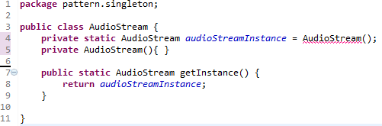
Singleton – example
A Singleton is a class that can have only one instance
  You may want to create just one AudioStream, so you can only play one tune at a time

Slide 42
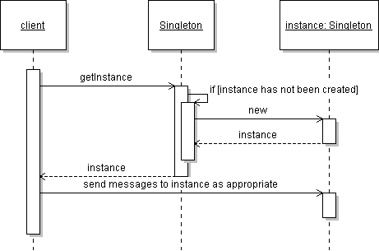
Singleton sequence diagram

Slide 43
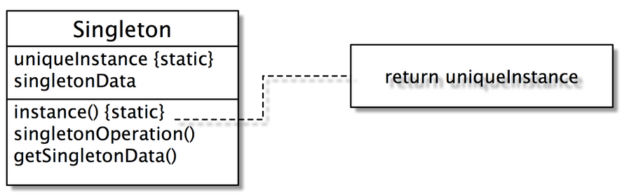
Structure

Slide 44
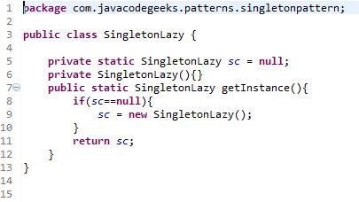
Singleton - Lazy initialization
10-<number>

Slide 45
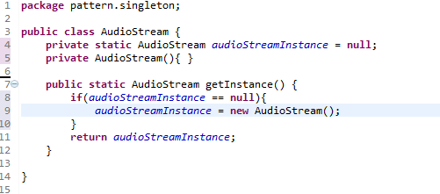
Lazy Initialization – E.g.
10-<number>

Slide 46
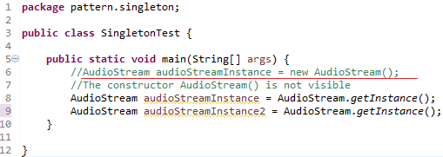
Singleton - Test
10-<number>

Slide 47
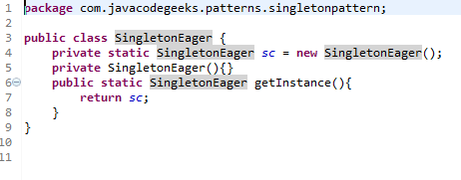
Solution: Eager Initialization
10-<number>

Slide 48
Comparison
 | Lazy Initialization | Eager Initialization
Defined | It will be new when user use it first time. | System will create it at the loading time.
Advantage | Reduce resource that be used, increase system efficiency. | Reduce the complexity of code, easy to maintain. Thread-safe. Can use single –Thread and Muti-Thread
Disadvantage | It probably creates two instances of the singleton class when two users use it at the same time. Not thread-safe (only use single-Thread) | It is more a waste of resource than Lazy initialization.

Slide 49
Some problem of Lazy initialization
Multithreading programming
  Two instances of the singleton class could be created
Some solutions
  Use eager initialization
  Synchronized instance method
  double-checked-locking

Slide 50
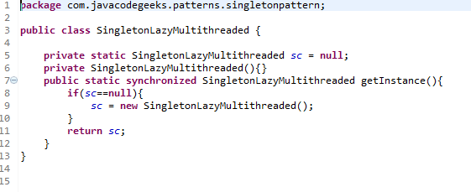
Solution : Synchronized instance method
Client call instance method and method will lock the instance every time
10-<number>

Slide 51
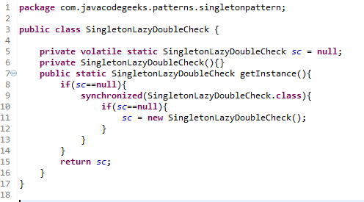
Solution: Double-checked-locking
Client call instance method and method will lock the instance at first time
10-<number>

